Slide 1
Appalachian Children Coalition
www.appalachianchildrencoalition.org
Where you live should not determine how you are treated.
Appalachian Children Coalition
Randy Leite, Ph.D. Tom Davis, Ph.D.
Executive Director Board President
leite@appalachianchildrencoalition.org
(740) 856-6031

Slide 2
Our Mission
Our mission is to improve the health and well-being of our region's children. Through collective advocacy and strategic investments, we aim for a future where every child has access to the care that they require at home, in school, and in their communities.
Appalachian Children Coalition
www.appalachianchildrencoalition.org
Where you live should not determine how you are treated.

Slide 3
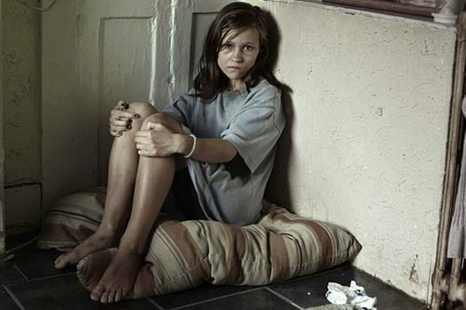
Why Appalachian Ohio
Concentrated Poverty
Exposure to Drugs
Shortage of Child Behavioral Health Specialists
Remote Acute Care Access
Lack of Broadband Access
Philanthropy Gap
Appalachian Children Coalition
www.appalachianchildrencoalition.org
Where you live should not determine how you are treated.

Slide 4
Our Priority Areas
Appalachian Children Coalition
www.appalachianchildrencoalition.org
Where you live should not determine how you are treated.

Slide 5
Activity Matrix
Broadband
Access
Continuity of
Crisis Care
Behavioral
Health
Integration
Whole- Child Models
Advocacy
Outcomes
Convening
Innovation
Communication Hub
Impact
Resource Generation
Insight
Workforce Development
Appalachian Children Coalition
www.appalachianchildrencoalition.org
Where you live should not determine how you are treated.

Slide 6
Coalition Member Organizations
Athens-Meigs Educational Service Center 317 Board of Athens, Hocking, & Vinton Counties
Brown County Educational Service Center Adams, Lawrence, & Scioto Counties ADAMH Board
East Central Ohio Educational Service Center Brown County ADAMH Board
Gallia-Vinton Educational Service Center Gallia-Jackson-Meigs ADAMH Board
Lawrence County Educational Service Center Harrison, Belmont, Monroe ADAMH Board
Muskingum Valley Educational Service Center Muskingum Area Mental Health and Recovery Services
Ohio Valley Educational Service Center Paint Valley ADAMH Board
Ross Pike Educational Service Center Tuscarawas and Carroll Counties ADAMHS Board
South Central Ohio Educational Service Center Washington County Behavioral Health Board
Appalachian Children Coalition
www.appalachianchildrencoalition.org
Where you live should not determine how you are treated.

Slide 7
Our Partners and Advisors
Hopewell Health Centers Integrated Services for Behavioral Health
Children’s Defense Fund-Ohio Perry County Behavioral Health Choices
Corporation for Ohio Appalachian Development Nationwide Children’s Hospital
Foundation for Appalachian Ohio Akron Children’s Hospital
Coalition of Rural and Appalachian Schools Athens County CASA/GAL
Ohio Alliance for Population Health Building Bridges 2 Careers
Ohio University Voinovich School Lights Recovery Network
Ohio University College of Health Sciences and Rural Action
Professions
Miami University Center for School-Based
Mental Health Programs
Appalachian Children Coalition
www.appalachianchildrencoalition.org
Where you live should not determine how you are treated.

Slide 8
ACC Governing Board
Tom Davis, Ph.D., Professor Emeritus, Ohio University (President)
Mark Snider, Principal, Snider, Fuller, and Stroh (Treasurer)
LeeAnn Johnson, Mental Health Advocate (Secretary)
Ted Strickland, 68th Governor of Ohio
Robert Taft, 67th Governor of Ohio
Robin Burrow, Principal, Eastern Elementary School
Nick Rees, Former President & CEO, The Buckeye Ranch
Mary Sabin, Vice President for Institutional Advancement, Lourdes University
Appalachian Children Coalition
www.appalachianchildrencoalition.org
Where you live should not determine how you are treated.

Slide 9
ACC Advisory Board
Cara Brook
Executive Director
Foundation for Appalachian Ohio
Earl Cecil
Former Director
317 Board
Fred Deel
Former Director
Governor’s Office of Appalachia
Orman Hall
Adjunct Professor
Research Lead
Ohio Alliance for Population Health
Lisa Harper
Youth & Family Services Program Coordinator
Perry Behavioral Health Choices
Rick Hodges
Assistant Clinical Professor
Director
Ohio University/Ohio Alliance for
Population Health
Lesli Johnson
Professor
Ohio University Voinovich School of
Leadership & Public Affairs
Jim Mahoney
Former Executive Director
Battelle for Kids
Rebecca Miller
Sr. Director of Community Relations
Ohio University College of Health Sciences
And Professions
Richard Murray
Executive Director
Coalition of Rural and Appalachian Schools
Tracy Najera
Executive Director
Children’s Defense Fund-Ohio
Debbie Phillips
Executive Director
Rural Action
Tracy Plouck
Assistant Clinical Professor
Behavioral Health Lead
Ohio University/Ohio Alliance for
Population Health
Megan Riddlebarger
Executive Director
Corporation for Appalachian Development
Sherry Shamblin
Chief Strategy Officer
Hopewell Health Centers
David Scholl
Venture Partner
Athenian Venture Partners
Samantha Shafer
Chief Operating Officer
Integrated Services for Behavioral Health
Jenny Stotts
Executive Director
Athens CASA/GAL Program
Appalachian Children Coalition
www.appalachianchildrencoalition.org
Where you live should not determine how you are treated.

