Slide 1
Educating the Whole Child
in Ohio’s Public Schools
Notes:
Thank you for having me come speak with you today about Educating the Whole Child and The Role of Ohio’s Public Schools. My passion for this subject has grown over time. When I was still in the classroom, I had no concept of “educating the whole child”. I knew that having a positive relationship with students and being a good role model were important, but I didn’t believe my role required me to help students become better people. My job was to teach them the ELA standards, and I took that role VERY SERIOUSLY. Ask any of my students.
If I’m honest with myself, I didn’t realize the importance of educating the whole child until I became a middle school principal. I’m sure, like many of you, the farther I got from my own classroom, the more I formed a bird’s eye view of all the facets of a child’s academic and social-emotional development.
Since then, I have learned about educating the whole child through my own experiences and research. Eventually, I began publishing my own work around this topic.
When I saw a job posting at the Muskingum Valley Educational Service Center for a Curriculum Director with a Whole Child Focus, I applied right away, and here I am today, excited to tell you what I know about this topic.

Slide 2
Essential Questions
What is the Ohio Department of Education’s Whole Child Framework?
Why do we need to educate the Whole Child?
How do we educate the Whole Child?
Notes:
From today’s presentation I will answer four questions for you: What is ODE’s Whole Child Framework?
Why do we need to educate the Whole Child?
How do PBIS, character education, prevention education and trauma-informed classrooms support the Whole Child?
And what resources are available to districts to support the Whole Child?

Slide 3
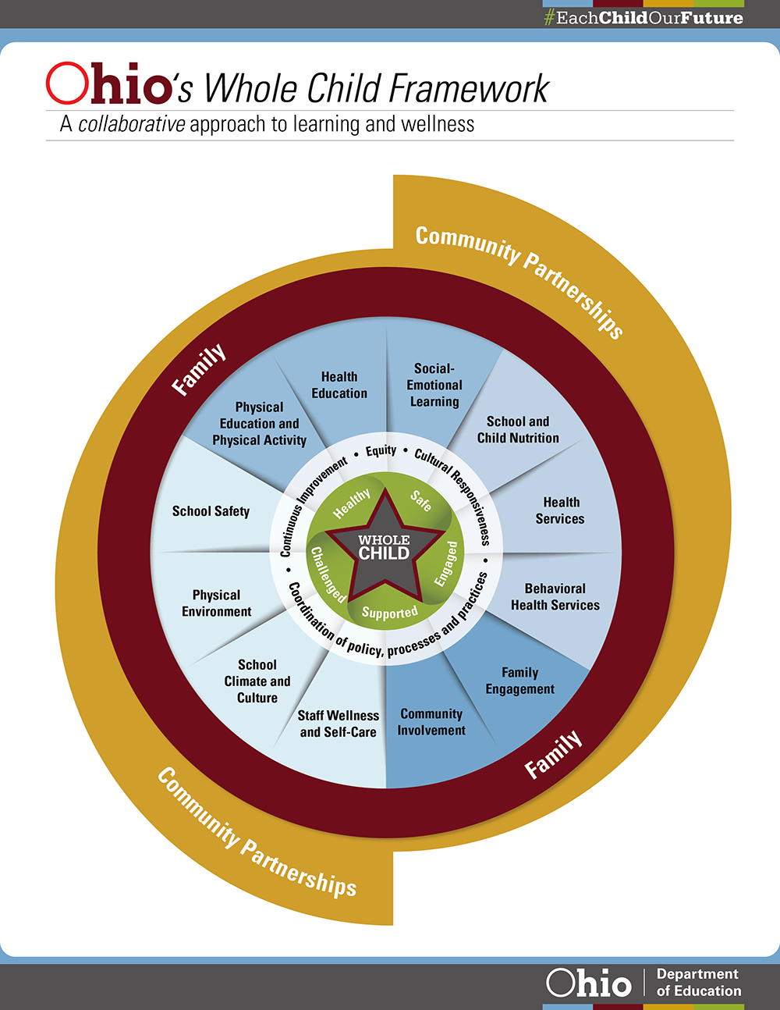
What is the Whole Child Framework?
Notes:
Part of ODE’s Each Child, Our Future, plan. It’s a collaborative approach to learning and wellness.
That wellness part is what I was missing when I was in the classroom, and it was missing in districts across Ohio, in a time when we need it most.

Slide 4
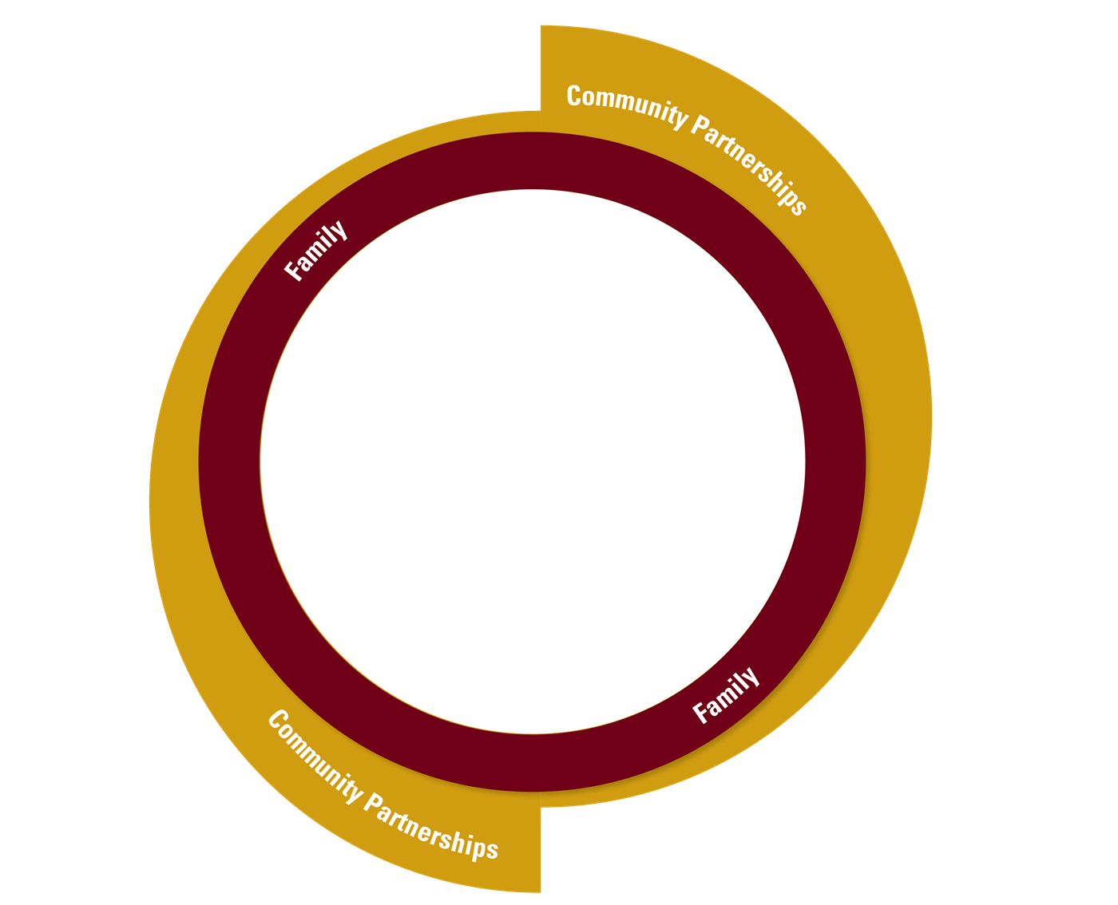
Notes:
So let’s zoom in on what “a collaborative approach to learning and wellness” means. It means COLLABORATING to educate the Whole Child Notice the verb I used there. COLLABORATING.
It is impossible for us to serve the Whole Child by ourselves. You know, I was talking to my brother the other day. He’s an engineer. He works with numbers and the laws of the physical world, BUT He is surrounded by educators. His wife, his sister, and his brother-in-law are all educators. He hears our chatter all the time. We talk about our students all the time. We talk about their families, their behavior at school. We talk about the social and mental health services they need and SOMETIMES receive. He knows they get free breakfasts and lunches. One day, he looked at me and he said, “Why don’t you just put bunk beds in the school, and the kids can just live there?”
After I was done mentally calculating how many bunk beds might fit in the middle school gym, I realized he was being sarcastic.
He was being sarcastic, but he has a good point. We tend to martyr ourselves in the service of students, don’t we? We would do well to remember that, however imperfect, our students DO have family. That family may not be the traditional nuclear family of mother and father and children. It may look like mom and stepdad, grandma and grandpa, or here in Appalachia, if you’re like some of my family, double half-cousins and ex-stepdads. Anyone who knows students well and takes a personal interest in their well-being qualifies.
As districts, we must collaborate by forming partnerships with Alcohol, Drug, and Mental Health Boards, otherwise known as ADAMHs. There are local clergy and community service agencies who are willing to help. And yes, your ESCs are here to help too.

Slide 5
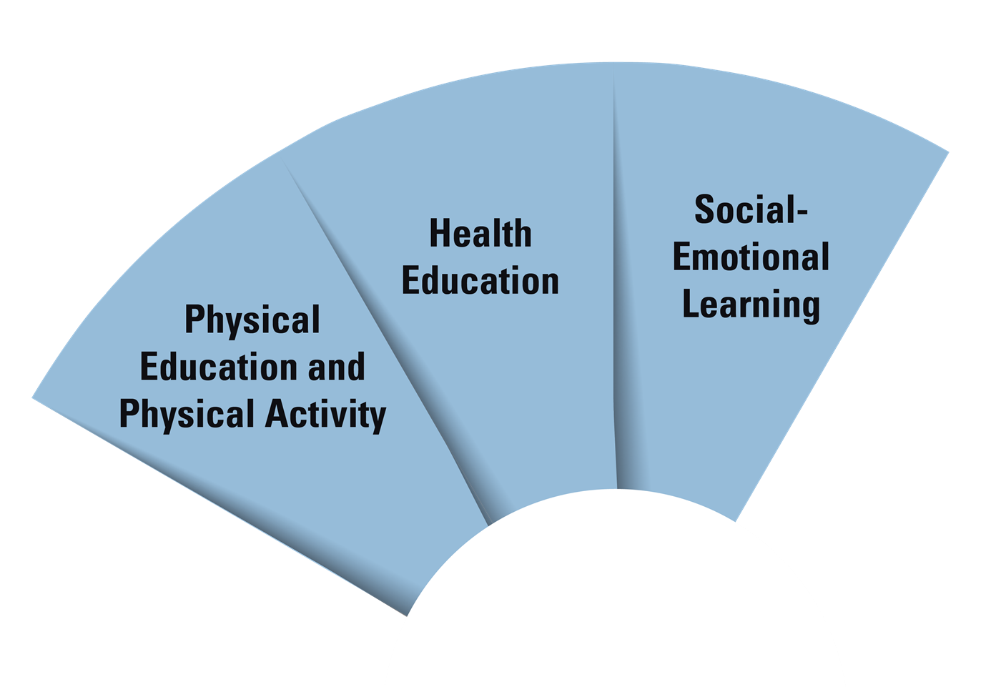
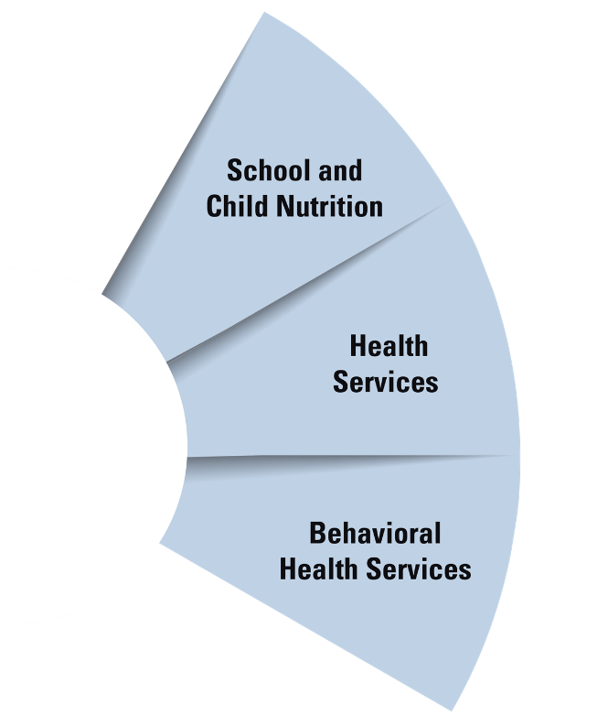
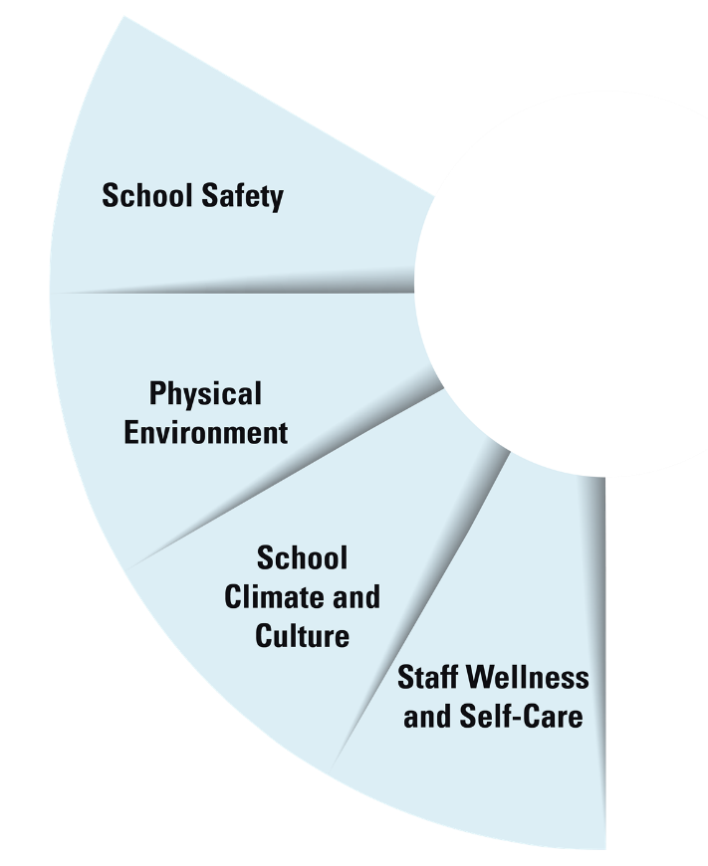
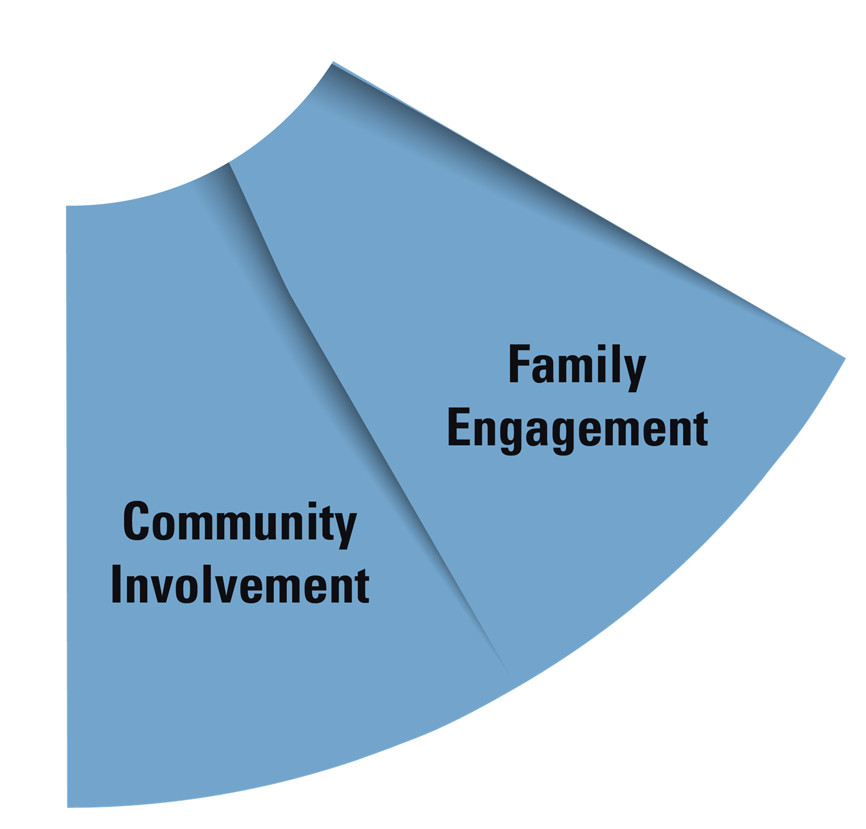
Healthy Behaviors
Services to Students and Families
Safe and Supportive Schools
Engaging Others
Notes:
So, what can we do as schools in our COLLABORATION to support the Whole Child?
This chart shows all the school and health support systems that available to support the Whole Child. Today, we are going to focus on the left side of this chart, addressing Healthy Behaviors and Safe and Supportive Schools

Slide 6
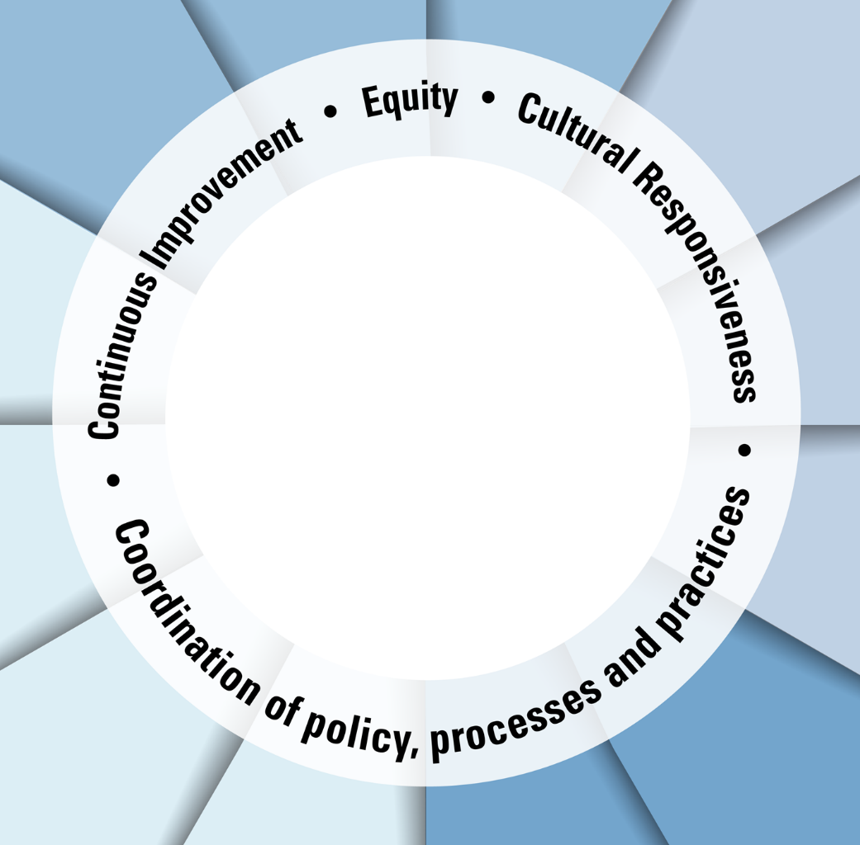
Notes:
For us as schools to provide for the Whole Child, we must continually improve by evaluating where our students are and what they need, as well as what our staff capacity is and what they need to be successful.
We must act with equity as we support the Whole Child. We all know the saying that fair doesn’t mean equal. That is the case here. Most children will only need Tier I Services most of the time. But some will need Tier 2 and some will need Tier 3. So while services are not EQUAL, they are EQUITABLE.
Supports are culturally responsive. An Appalachian family and an urban family may respond very differently to government interference with their families. In Appalachia, we take care of our own and the intrusion of government agencies may feel uncomfortable for them at first. We must work with families to gain their trust.
We must coordinate our policies, our processes and practices within each agency and between agencies as we work together.

Slide 7
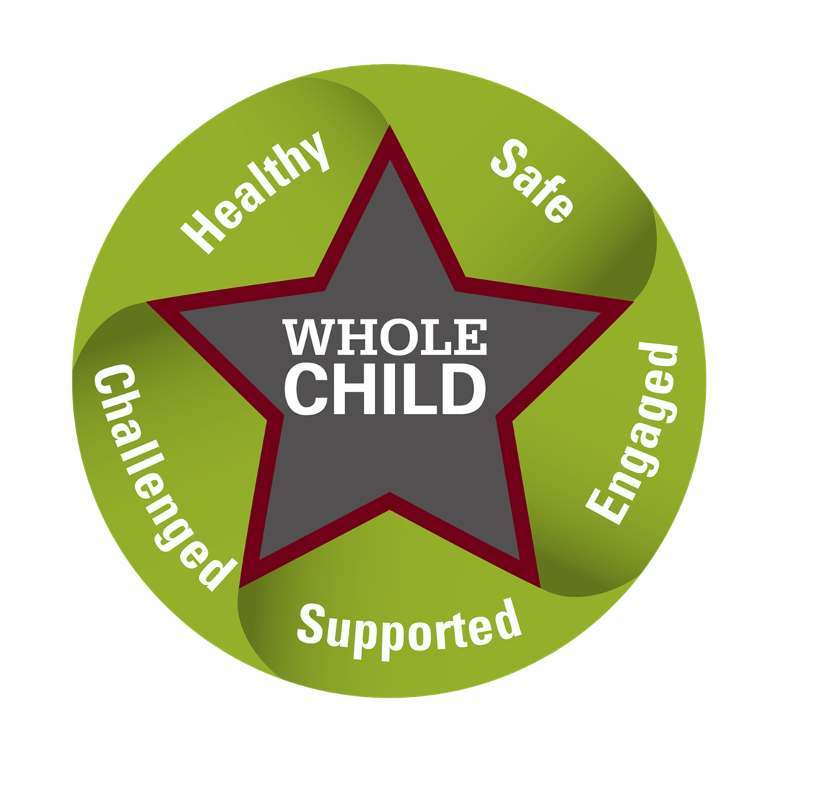
Notes:
When we focus on the whole child, They are more likely to enjoy learning, develop positive social skills and achieve greater success. So instead of standards being the center of our model here, the child is the center.

Slide 8
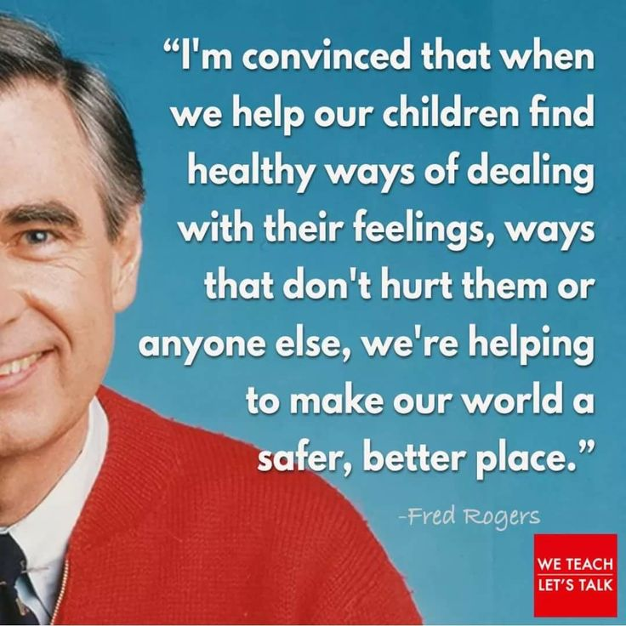
Why do we need the Whole Child approach?
Notes:
I could cite statistics on obesity, drug abuse, mental health, divorce, etc. to prove why we need to educate the whole child, but the truth is, even kids from two-parent households who live healthy lifestyles free of addiction and mental health issues, still benefit from a whole-child approach. It is for everyone. We ALL benefit from being seen as whole people.
Back-to-school night. Ask parents what they want for their child? Across economic, religious, racial, and regional demographics, common answers include self-motivated, lifelong learners, happy, kind, and curious. We all want these things for our children. If we want to create a society full of children with those qualities, we must work together.
Mr. Rogers quote: That sums up the Whole Child Approach. We all share responsibility. They are our children. It is our community. It is my world. And therefore, it is my problem

Slide 9
How do we educate the Whole Child?
Three Ways to Get Started:
PBIS
Character Education
Trauma-Sensitive Classrooms

Slide 10
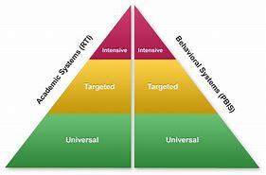
What is Positive Behavior Intervention and Support (PBIS)?
Notes:
Remember when we talked about coordination of policies, procedures, and practices? That is where this comes in. Serving an entire child is complex. To keep our work manageable and effective, we have to work within well-designed systems.
So, we are used to thinking about academics this way. We start with our universal classroom instruction. If a child needs extra help, we go through the Response to Intervention process. Today, we are going to focus on the other half of this triangle, PBIS piece.
Universal-everyone
Targeted-small groups, little extra help
Story of first year as principal
Intensive (1%-5% of population), individualized

Slide 11
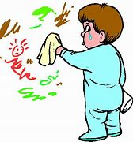
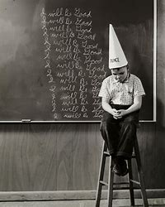
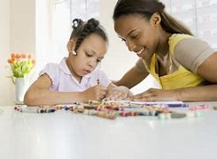
Traditional Discipline vs. PBIS
Humiliation and Punishment vs. Restoration and Reteaching
Notes:
How many of you ever had to do this in school? Probably many of you have.
Go over differences between the two
Humiliating practices—punishment (dunce cap) vs. Restorative practices—restoring the wall to its original condition, which also isn’t fun but is a logical consequence
In this situation, we might also re-teach the child what we do with markers. Practice using them on paper, instead of the wall.

Slide 12
Best Practices for PBIS
Measurable Goals centered around behavioral and academic outcomes
Consistent Tracking and Analyzing
3-5 Behavioral Expectations that are defined, taught, and retaught.
Collaboration with families and community
Notes:
Measurable goals ex. 25% decrease in hallway behaviors.
Consistent tracking and analyzing—data shared at meetings and acted upon
3-5 behavioral expectations—ex. Respectful, Responsible, Safe, and Kind
Collaboration with families and community—volunteers to run reward cart, and counselors as needed

Slide 13
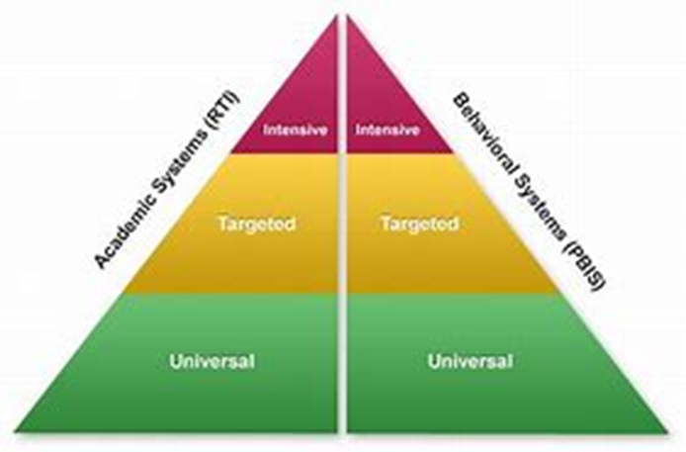
What is Character Education?
Character
Actions
Feelings
Thoughts
Notes:
According to education author Thomas Lackona, the “purpose of education is to help people become smart, and to help them become good.” As educators we spend most of our time making student smarter. We also need to make them better. Feelings, thoughts and actions all work together to form character. Character education is the act of teaching students how to regulate those feelings, thoughts, and actions into pro-social behaviors.
Character ed MUST be part of our Tier I Whole Child Framework. However, Tier II supports may include small group work around specific positive character traits, while Tier III may be individual support with a social worker.

Slide 14
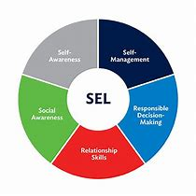
The Importance of Character Education
Notes:
One common complaint about character education is that character “should be taught at home, not at school”. That complaint usually falls right after a complaint about “kids these days.”
The truth is that character education has always been important, but its relevance has varied over time. In the eighteenth century, our new nation’s leaders understood that democracy required virtuous citizens who could exercise their rights responsibly. As the majority of our nation’s populace was Protestant Christians, the Bible was the primary source of character education. Character education was taught through the lens of religious morality.
As more immigrants arrived from predominantly Catholic countries, controversy arose over the correct source material for teaching good character. This is where secular texts such as McGuffey Readers offered values-based instruction that was applicable to a more diverse population.
As Americans began to question traditional power structures in the 1960s, character education declined in American schools. This is in part due to the rise of moral relativism, a more pluralistic society, and the misconception that teaching character means teaching religion. By the end of the 1970s, character education was reduced to teaching thinking skills, rather than instructing students in specific values.
In the 1980s, character education made a resurgence, thanks to the “war on drugs” and the desire to reduce violence. Once again, schools were encouraged to offer direct instruction in character education.
Since then, we have come full circle to educating the whole child. The Whole Child Initiative encourages wraparound education that addresses students’ need to be “healthy, safe, engaged, supported, and challenged”.
Today’s character education curriculum emphasizes Social-Emotional Learning (SEL). According to The Collaborative for Academic, Social, and Emotional Learning (CASEL), SEL is the “process of being able to identify and manage our emotions, set and achieve positive goals, feel and show empathy for others, establish and maintain positive relationships, and make responsible decisions.”

Slide 15
How to Implement Character Education in Your District
Begin with the end in mind
Share Leadership
Emphasize Relationships
Make it a daily ritual
Make it building-wide
Stay flexible
Notes:
How to Implement Character Education Programs in Your School
Begin with the End in Mind
Start by establishing expectations for your program. Decide with your Building Leadership team (BLT) what you expect out of students and make those expectations very clear to everyone in the building. If you’re choosing a program, make sure the one you choose matches the habits your building values. I used P2 which is based on building 24 positive the positive character traits that we all possess, versus reducing negative traits. I know Stephen Covey’s Leader in Me is also very popular. I like that Leader in Me has a tight focus on 5 Paradigms to SEE differently.
Share Leadership
Chances are good that you have a teacher or group of teachers that is passionate about character education. Share leadership with these folks and work to establish teacher buy-in. One of my teachers brought me P2. She had some experience with it and because she was an influencer with her peers, others had buy-in too.
Emphasize Relationships
Study after study shows that students learn and behave better for people with whom they have a positive relationship. It is no different when it comes to character education. Teacher with negative relationship with students built on punishment gets terrible results.
Make it a Daily Ritual
Incorporate direct instruction in character education EVERY DAY. By all means possible, institute a homeroom or advisory period that meets daily. The daily interaction also establishes relationship building that is so important for building character. Weekly video announcements centering around character education allow you as the building leader to set the tone for the rest of the building. A daily recitation of school expectations is also a consistent reminder of school values. Be Respectful, Responsible, Safe and Kind every day for instance. Sacred time. Not for make-up work, etc.
Make it Building-Wide
In general, every student should be participating in the same character education program at the same time. This allows you to establish consistent language surrounding character, which makes communication easier among the building population. It also allows for more meaningful discussions with students. Have it posted everywhere. Which of these character traits were you lacking? Yes, yes, when you took a picture of me and drew a mustache on my face and posted it on social media, that was not kind
Stay Flexible
Even if you pick a great character education program, sometimes you will have to veer off-plan a little. As long as it is in the best interest of students, you are on safe ground. Made it a point to my teachers that yo udo not have to follow every day’s slide to a tee. If you get going on a meaningful convo, keep going with it. As long as it’s relevant.

Slide 16
Your Brain on Trauma
Notes:
I don’t know if any of you remember in the 80s Barbara Walters did a 20/20 piece about Romanian orphans. I was so upset by that show. I wanted to go to Romania and help my parents adopt all the orphans and bring them back here. They were in cribs all by themselves all day long with no human interaction. NO one hugged them, talked to them, or seemed to do anything but provide the most basic care.
This is a brain scan of a Romanian orphan who was institutionalized right after birth. Temporal lobe is not as active in the abused brain as in the typically developing brain. This is the part of the brain that regulates emotions and helps us make decisions.
Their brains are not wired the same way as a child with out all these ACEs. But here’s the thing: While most of our students are not Romanian orphans, most of them have experienced some sort of trauma in their lives. For that matter, so have most of us in this room right now. 70% of adults in the US have experienced some type of trauma, according to the National Council for Behavioral Health.
It leads to problems such as learning and behavior, increased health and mental illness, and because of poor decision-making abilities increased involvement with the juvenile justice system

Slide 17
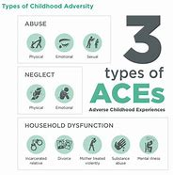
What is Trauma?
Types of ACES – graphic from KVC Hospitals
Notes:
Physical abuse
Emotional abuse
Emotional neglect
Sexual abuse
Physical neglect
Household substance abuse
Mother treated violently
Parental separation or divorce
Household mental illness
Incarcerated household member

Slide 18
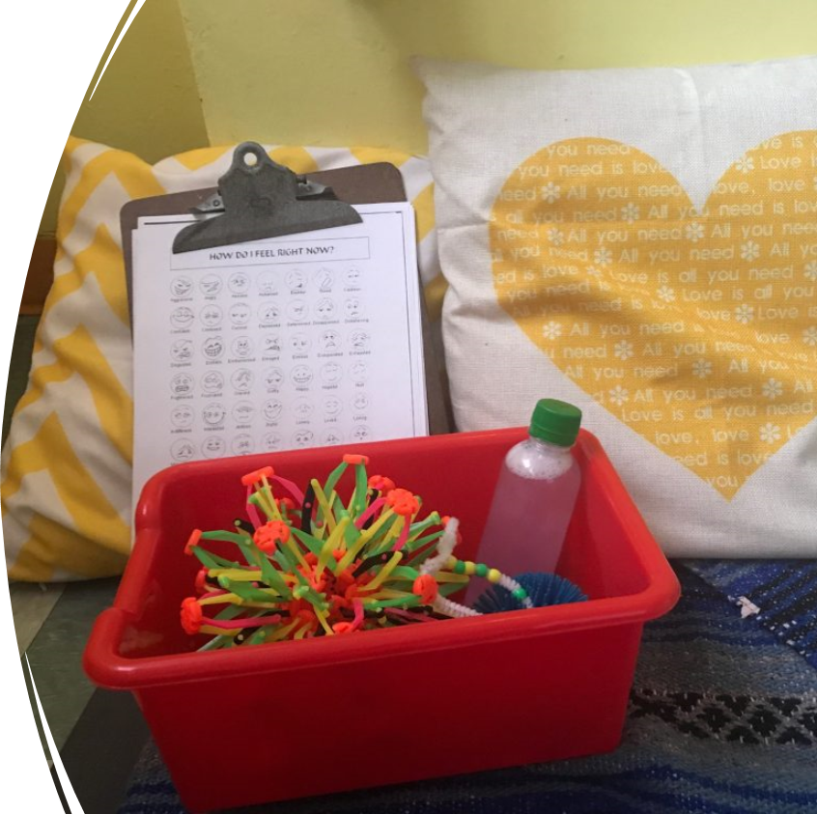
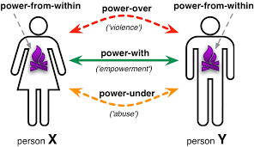
Trauma-Sensitive Strategies
Create a Safe Space
Be Predictable
Build Trust
4. Offer Choices
5. Stay Regulated
Slide adapted from Amy Luby, MVESC
Notes:
Creating a safe space—quiet or cool-off corner, clam music, dimmed light, flexible seating, calm adults (not too much, Pinterest shouldn’t explode in your room)
Be predictable—schedules, behavior matrix, always be there at the door, tell them about changes, prepare them for transitions
Build Trust—follow through on promises, don’t lie, make a connection (releases bonding hormone oxytocin)
Offer Choices—have power-with, we’ll do it together, We can do this worksheet and then this art project. We can write it this way. What do you think?
We all know the teacher who has to “win”. Don’t be that dude.
Stay Regulated—Sluggish? Go to recess. Over-stimulated belly-breathing or meditation time.

Slide 19
Ask Yourself This Question.
"If decisions about education policy and practice started by asking what works for the child, how would resources—time, space, and human—be arrayed to ensure each child's success? If the student were truly at the center of the system, what could we achieve?"
—Dr. Gene R. Carter (The Learning Compact Redefined: A Call to Action, p. 4)

Slide 20
Resources
My articles:
https://www.teachhub.com/teaching-strategies/2019/11/implementing-a-pbis-program-from-scratch/
https://www.graduateprogram.org/2020/03/what-is-character-education/
Other resources:
Ohio's Whole Child Framework | Ohio Department of Education
Center on PBIS
Improving Approaches to Trauma Informed Care - YouTube

Slide 21
Thank You!
Presented by
Lindsay Rayner
Director of Curriculum and Learning, Whole Child Focus
lindsay.rayner@mvesc.org

